Slide 1
COMP90018 Mobile Computing Systems Programming
Prof. Vassilis Kostakos

Slide 2
Advanced evaluation techniques
How to measure performance of
large numbers of people
from remote settings (e.g. online, distributed)
using large datasets
We want to determine
What happened / what did people do?
What does it mean?
What does it tell us about people?
“Community Imaging”
Understanding people through their use of technology.

Slide 3
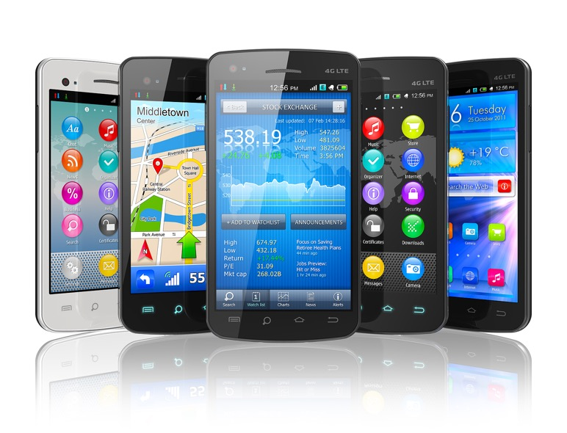
Smartphones
Online behaviour
Human Computation &
Crowdsourcing

Slide 4

Do phones create habits?
We built an app and deployed to an appstore. The app collects data.

Slide 5
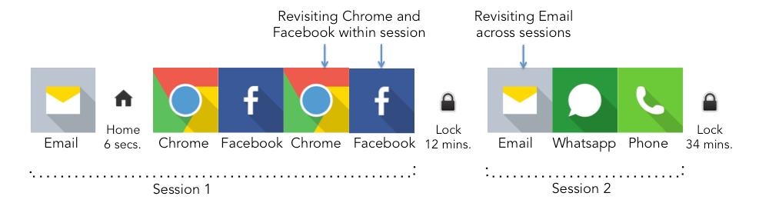

Slide 6
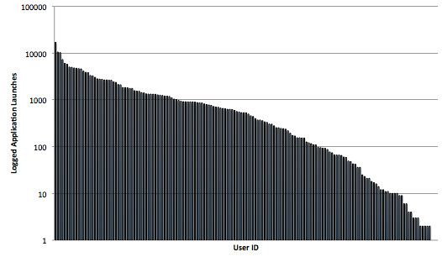
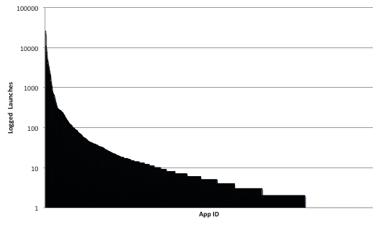
Differences in launching
Y-axis is LOGARITHMIC!

Slide 7
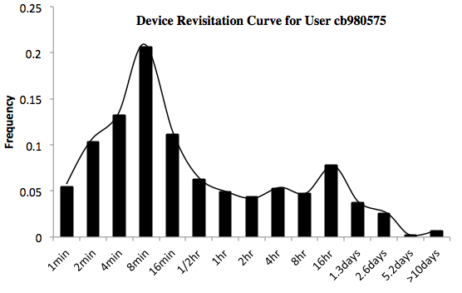
Histograms per user

Slide 8
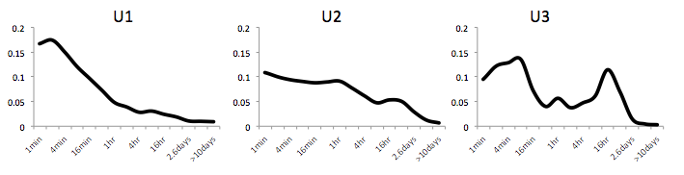
Patterns emerge (users)

Slide 9
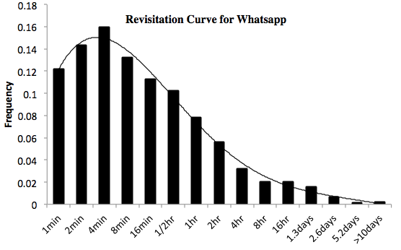
Histograms per app

Slide 10
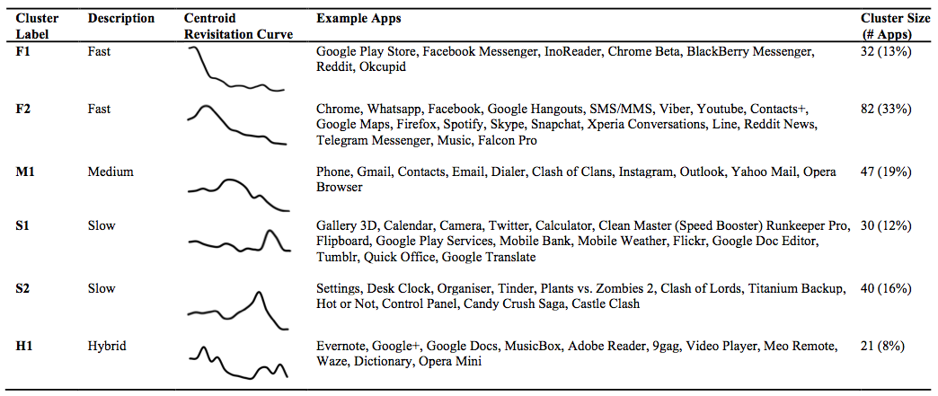
Patterns emerge (apps)

Slide 11
Compare to Web revisitaton (2000’s)

Slide 12
Similar patterns. What does this mean?
Do phones create habits?
Technology A
Technology B
Behaviour

Slide 13
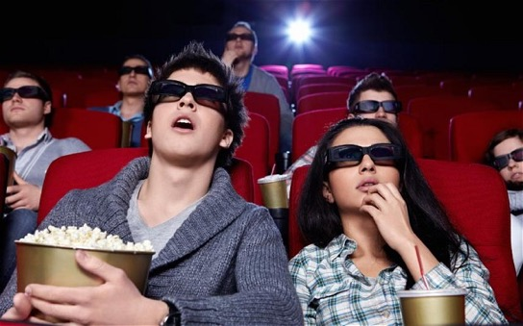

Online behaviour is a proxy
Can online behaviour be used as a proxy for studying urban mobility?

Slide 14
WiFi access points

Slide 15
Across a whole city – 3 years
Upward trend.
Needs normalisation.

Slide 16
Notice that the y-axis is now 0~1

Slide 17
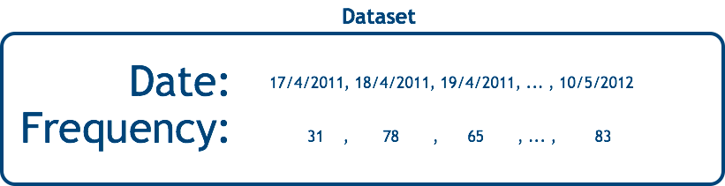
Each location has a pattern

Slide 18
Google web searches also have a pattern

Slide 19
“Google Trends” lets us match the patterns

Slide 20
Which keyword patterns match to a location patterns?
University | r-value
Helka (Helsinki university library) | 0.914
google scholar | 0.895
scholar | 0.894
tutkimus (research) | 0.893
learning | 0.887
optima oulu (student environment) | 0.878
funktio (function) | 0.876
luento (lecture) | 0.874
development | 0.872
nelli (university e-library portal) | 0.871

Slide 21
Which keyword patterns match to a location patterns?
Ice hockey hall | r-value
sjl (Finnish ice hockey union) | 0.726
finnhockey | 0.724
keilahalli (bowling hall) | 0.722
kiekko kaleva (hockey in local newspaper) | 0.716
sm-liiga nelonen (tv-channel with hockey) | 0.715
nelonen sm (same as above) | 0.713
jääkiekkoliitto (ice hockey union) | 0.711
nelonen sm liiga (tv-channel, ice hockey) | 0.707
lihapata (meat stew) | 0.699
finhockey | 0.699

Slide 22
Which keyword patterns match to a location patterns?
High school | r-value
wilma kempele (student environment) | 0.795
wilma kiiminki (student environment) | 0.791
helmi (student management system) | 0.781
wilma oulu (student environment) | 0.771
edu (news and info on education) | 0.763
wilma kuusamo (student environment) | 0.758
pedanet (support for online learning) | 0.747
wilma raahe (student environment) | 0.744
wilma kemi (student environment) | 0.736
varoitusmerkit (warning signs) | 0.726

Slide 23
Similar patterns. What does this mean?
Technology A
Technology B
Pattern

Slide 24
Human Computation & Crowdsourcing
Can we use humans to solve problems that are hard for computers?
Reliable memory
No
Yes
Understands context
Yes
No
Reliable calculations
No
Yes
Fast calculations
No
Yes
Sensory translation
Yes
No
Can do research
Yes
No

Slide 25
Offer decision-support to humans (not answers)

Slide 26
Which car should I buy?
 | Price
Volvo

Slide 27
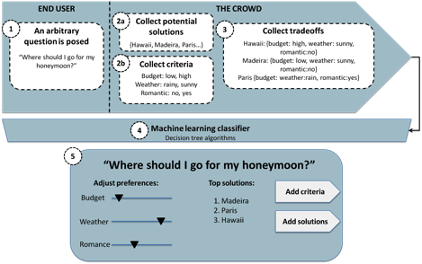

Slide 28
Things to evaluate
Is a solution “good”? (BMW, Mercedes, Donkey)
Is a criterion “good”? (Price, Safety, Swag)
Is the decision-support system “good”?

Slide 29
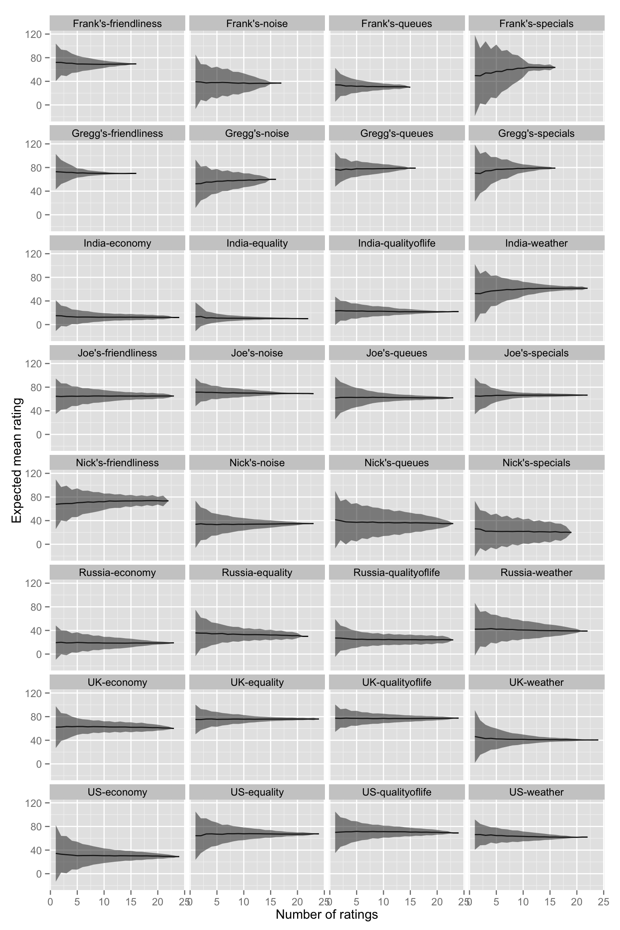

Slide 30
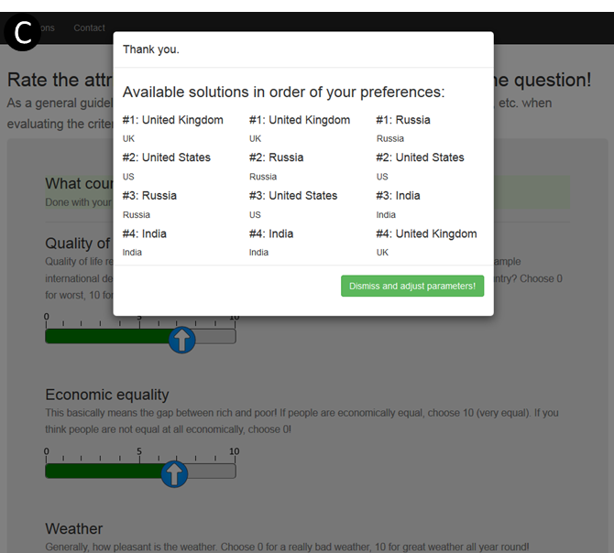

Slide 31
Closing thoughts
Advanced research helps us reflect on
People
Behaviours
Patterns
Research is crucial to understanding existing technologies
And developing new ones!

